Slide 1
How to enter the global market？
FSDL Public Course
Lecturer：Spencer Won
Support From：RxLibra.com
FSDL｜FoundationStone Develpment for Laos

Slide 2
CONTENT
How to enter the global market？
The first step to enter the global market is to become a foreign trade salesman.
Another way:
Cross-border e-commerce
Foreign trade salesman who can use the Internet
6H
  How to become a foreign trade salesman?
  How to learn English?
  How to find customers?
  How to communicate and negotiate?
  How to complete an order?
  How do you manage your time and allocate your work?
RxLibra.com
LienTeh.net
FoundationStone Develpment
In the last part: ask me

Slide 3


H1
  You want
  You really really want
  It’s not about the money
  Participate in global trade
  It allows us to meet many different people
  It allows us to meet many different things
  It can make our life more colorful
  It's a way of life
  How to become a foreign trade salesman?
  77.53 Billion People
  233 countries and regions
  6,000 different languages ​​worldwide
  Positive Attitude
  Professional Quality
  Rich product knowledge
  keen marketing awareness
  Pursue excellence

Slide 4
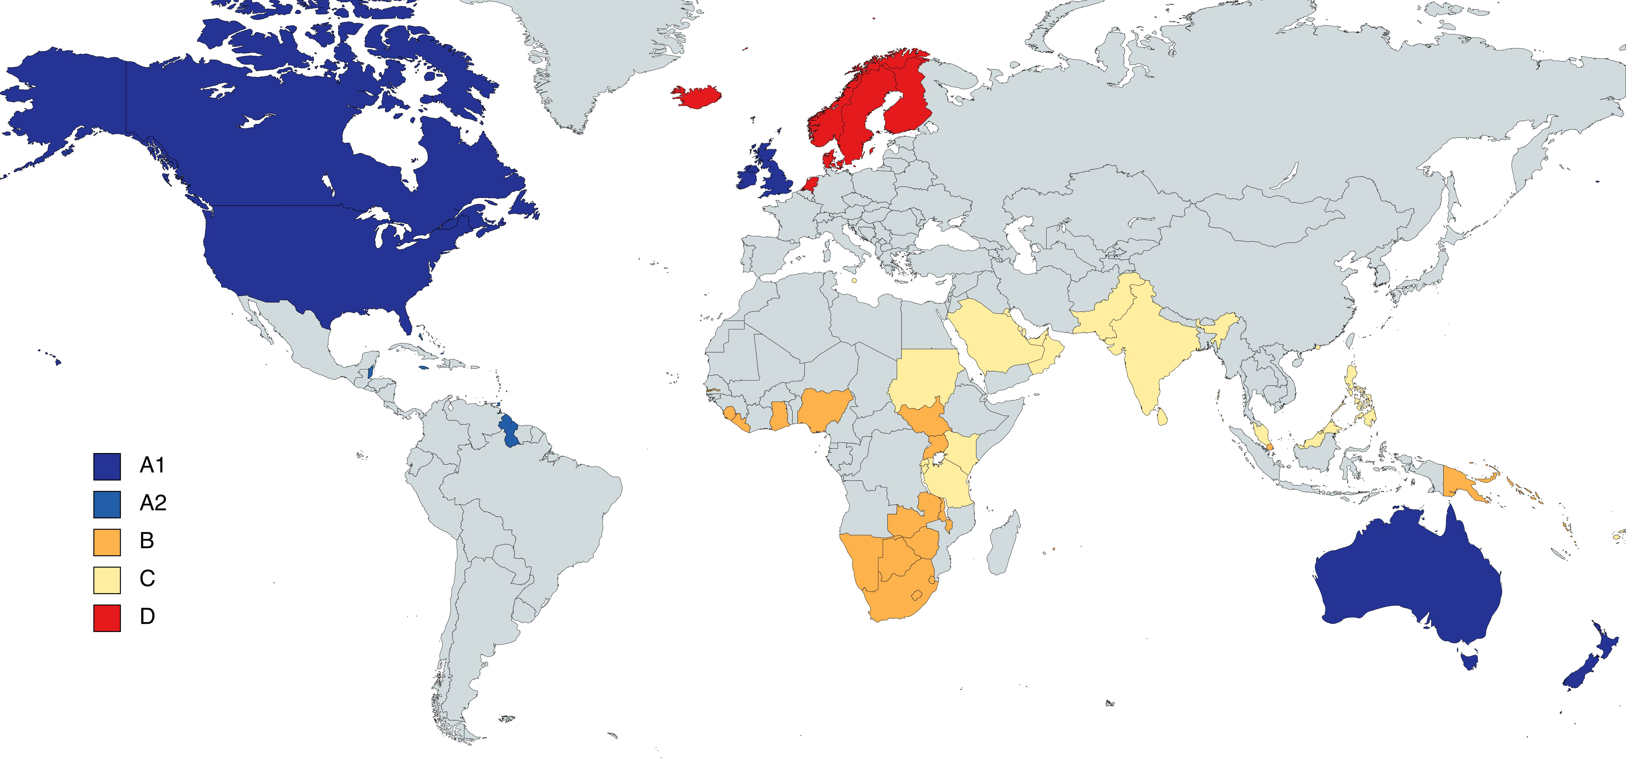
H2
  How to learn English?
Why study English?
  Because English is the de facto standard language for international trade.
Don't be afraid the mistake if you’re talk
  English is not a native language in most countries, people who may communicate with you may speak English worse than you.
  English is simple
  English is a phonetic text, as long as you learn to spell, you can already use English for communication.

Slide 5
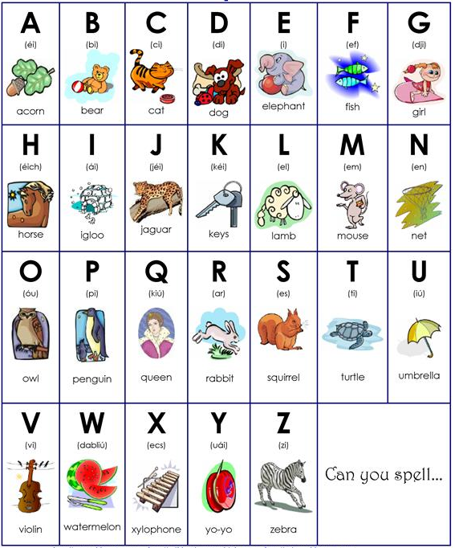

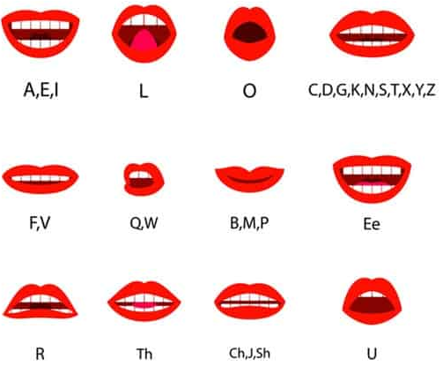
H2
  How to learn English?
  Step 1
  Letters & Pronunciations
Alphabet
  Spelling Rules
  1 day to 1 week Master

Slide 6
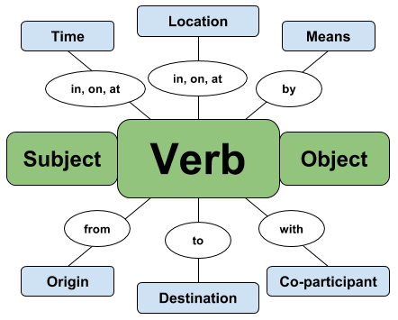
H2
  How to learn English?
Most sentences in English are constructed using one of the following 5 patterns:
  Step 2
Subject–Verb
Subject–Verb–Object
Subject–Verb–Adjective
Subject–Verb–Adverb
Subject–Verb–Noun
S+V+O
Subject+Verb+Object
For Example：
I love you
Basic English sentence structure
  All sentences include two parts: the subject and the verb (this is also known as the predicate)
The most basic structure
S+V+O
Subject+Grammar
Verb+Tenses
Object
I,my,mine
We,Us,Our
You,your
He,Him,His,
She,Her,hers
They,Them,Their
It..
etc...
Predicate verb:
Be,Is,was,Are
Do,Did,Does,Done
etc...
Non-finite Verbs:
learn,study, play, do, read, drive, write, clean, slean, sleep, speak, talk, wait, fly, stay, write, sit, stand,
etc...
Noun:
Plane、Computer、Cat、Someone、Caffe、Ticket、Car、
Visa、etc...
Accumulate words
  1 week to 1 month Master

Slide 7

H2
  How to learn English?
  Helper
  Google Translate
  Bing Translator
  Translatedict
  Translate.com
  DeepL Translator
  PROMT Online Translator
  Collins Dictionary Translator
  ImTranslator
  SpanishDict
  Reverso
  etc..
  Communication barrier is a real thing. And doubly so if you are dealing with a script that's totally unfamiliar to you. Any of these online translators can get the job done.
  Step 3
Accumulate professional vocabulary in the industry
  Reading and using
  Using translation software
  1 month to 3 months Master

Slide 8
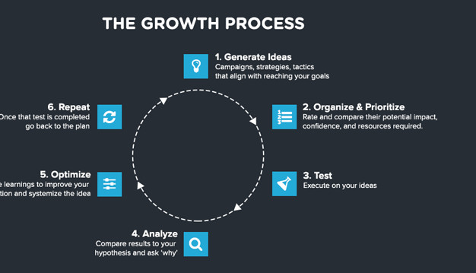
H3
  How to find customers?
  First
  Develop a strategy & a plan for customer acquisition in the Internet Age.
  For many small businesses, the hardest thing is finding clients or getting customers. Customer acquisition is particularly difficult if your marketing budget is limited. Finding customers is one of the most difficult challenges for startup and established small businesses.
  Having a great product or service that you’re sure many people will need isn’t good enough. Customers won’t find you, your store, your website, or your Facebook page just because you start a business. You have to go out and find potential customers and clients.
  In fact, customer acquisition needs to be an ongoing focus for most businesses. Even successful businesses will have customers or clients who stop buying for one reason or another. Those customers have to be replaced just to keep your business on an even keel.

Slide 9
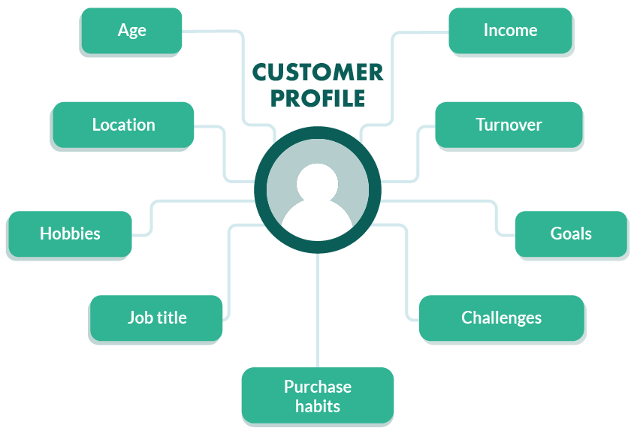
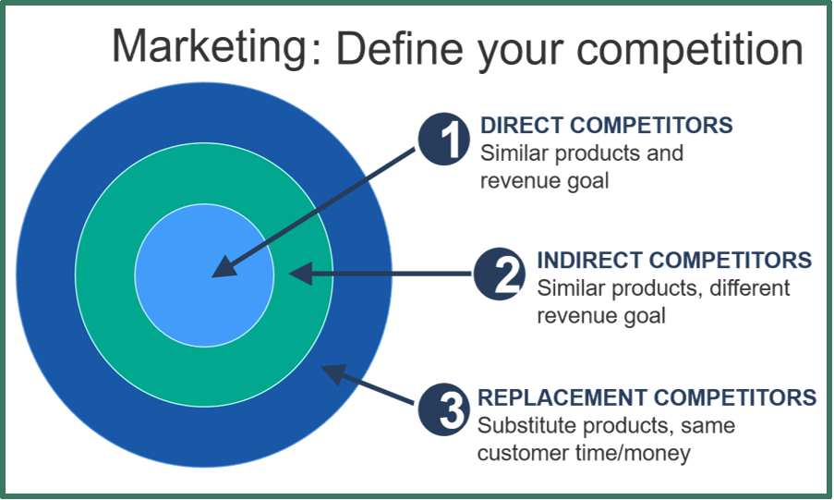
H3
  How to find customers?
  A plan & a strategy for Who?
  For Buyers&Customer.
  Primary
  who will to buy?
  Who would make the ideal customer.
  Secondary
  Study your successful competitors.
  What works for your competitors may work just as well for you.

Slide 10
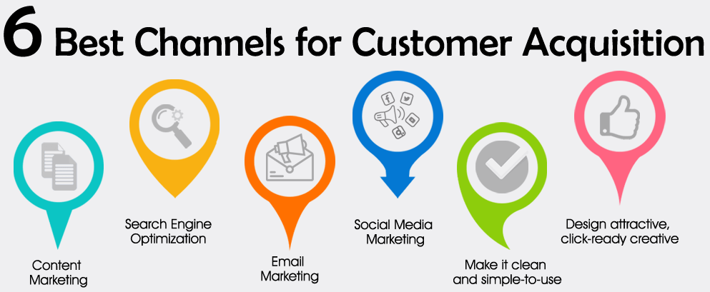

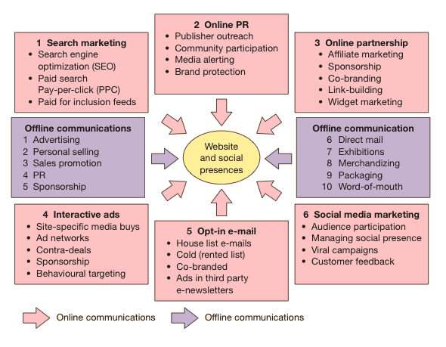
H3
  How to find customers?
  Weekly meeting: Goals
  The strategy
  What channels and resources are used?
  The Plan
  What to do first, then what to do second?

Slide 11

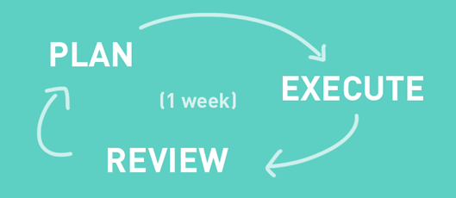
H3
  How to find customers?
  Routine Task
  Execute the plan
  Promote sales
  Drive sales
  Review
  Poor sales means that some methods are ineffective
  Weekly meeting:Review
  Realize there is more than one path to success.
  Whichever way you choose, going back to basics can help drive sales performance.

Slide 12
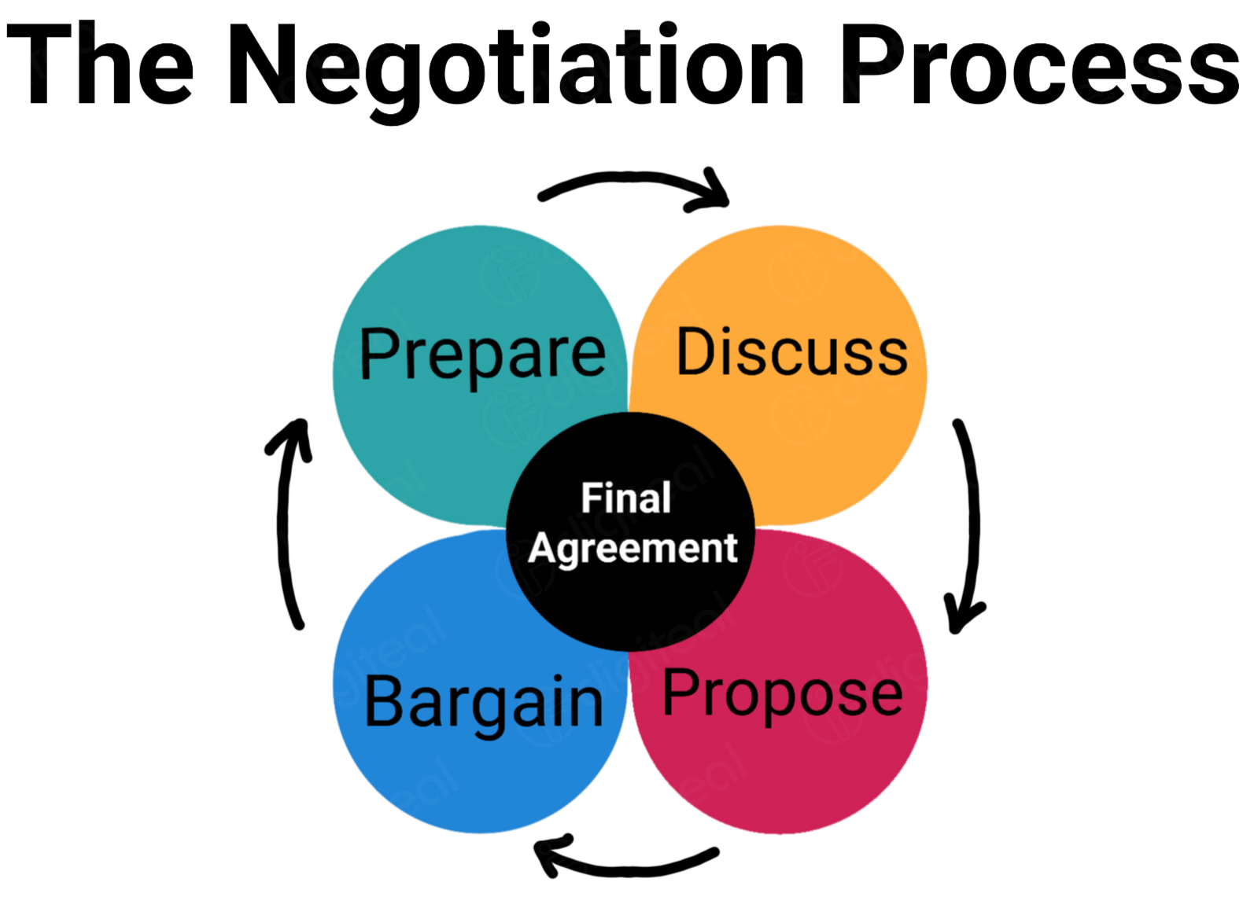
H4
  How to communicate and negotiate?
  Effective Communication & Negotiation
  Negotiation is nothing but a discussion among individuals to reach to an alternative which would satisfy all.
  How is an effective discussion possible ? Only through communication.
  Building Trusting Relationships
  Customer Ask Questions & You Answer
  Record and prepare your own Q&A List
  This will allow you to quickly become an expert in the field of change.
  Before any important deal, do make it a habit to go through as many details as you can. The Customer might ask you anything, you must be well prepared to clear all their doubts and convince them. If you yourself are confused, he would never bother to listen to you.
  React sensibly - A good negotiator must react sensibly. He should never lose his temper or over react.
  Patience - One needs to be patient enough for a good negotiation. It is not always that the other person will accept your suggestions in the first attempt itself. You need to convince him and it needs patience.
  Confident - One needs to be confident enough for an effective negotiation. You might need something but never show your desperation to anyone. They will take undue advantage of your helplessness.

Slide 13
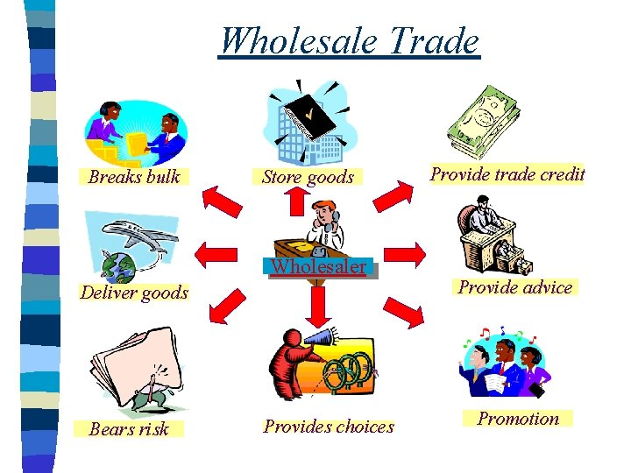
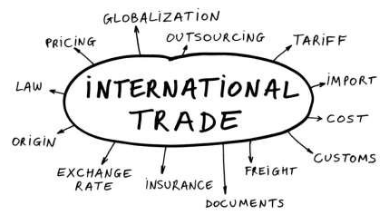
H5
  How to complete an order?
  Professional logistics company&customs declaration company
  Collection
  L/C(Letter of Credit)
  COLLECTION
    D/P(Documents against Payment)
    D/A（Documents against Acceptance）
  REMITTANCE
    M/T(Mail Transfer)
    T/T(Telegraphic Transfer)
    D/D(Demand Draft)
  IN CASH
    P/N(Promissory Notes)
    In Cash
    Cash Draft
  O/A (Open Account)
  FREE (Usually for sample)
  Three common trade quotation terms
  1.FOB,Free on board
  FOB refers to a trade term in which the exporter needs to deliver the goods to the specified port within the time specified in the contract, place them on the importer's ship, and timely notify the buyer to operate.
  2.CNF,Cost and Freight
  The term CNF refers to the cost and freight required by the seller to transport the goods to the port of destination.
  3.CIF,Cost,Insurance and Freight
  The term CIF in which the buyer is responsible for concluding the contract of carriage from the place of departure to the place of destination, paying the normal expenses, insuring the goods and paying the insurance premium.

Slide 14
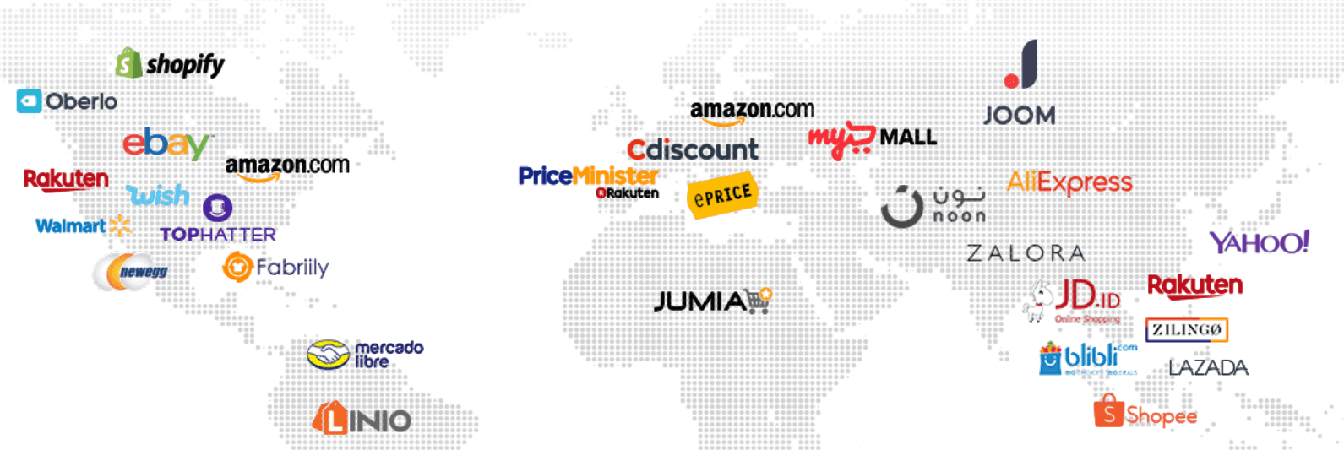
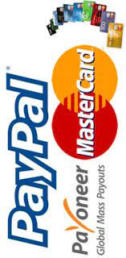
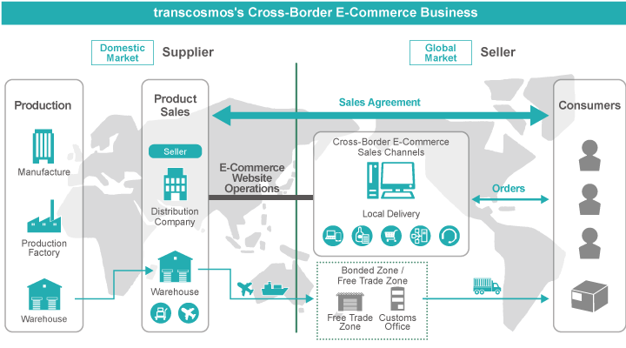
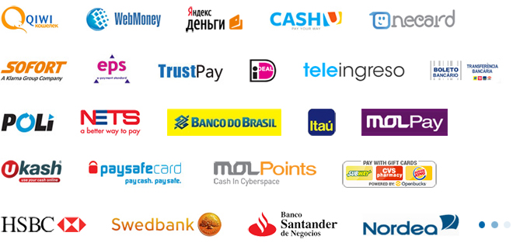
H5
  How to complete an order?
  Cross border E-commerce
  platform&Independent Website
  Professional service provider
  There are professional service providers in each linkShipment, collection, tax declaration There are professional service providers in each link

Slide 15
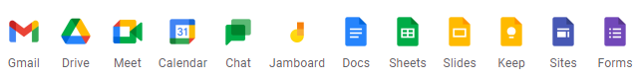
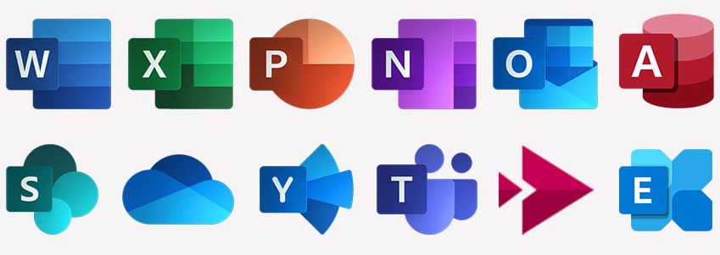
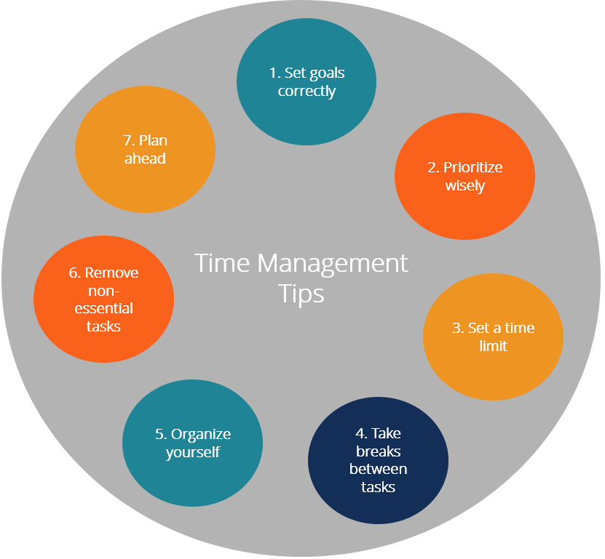
H6
  How do you manage your time and allocate your work?
  Online office Tools
  Establishing good working habits will benefit you for life
  Google Workspace
  Microsoft Office 365
  etc...

Slide 16
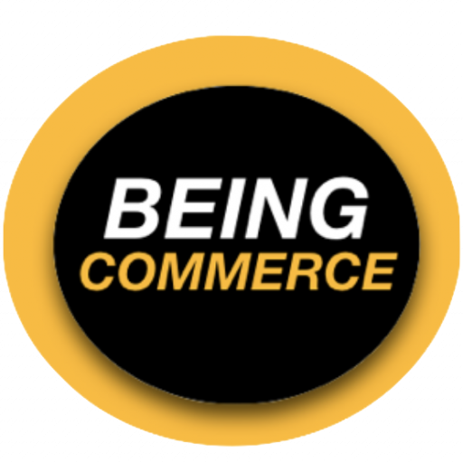
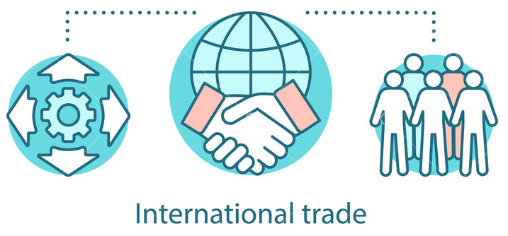
THE END
Are you ready Start-up?

